Slide 1

Cultural Life Information Homepage
소프트웨어학과
정해경

Slide 2



01 Self-introduction and role in projects
Name: Jung Hae Kyung Department: Software Project Class : Open Source Specialized Project Key roles: Team Project (Team Leader)
1. Coordinating team members' opinions 2.Document Creation Management 3.Data management 4.Model part coding and management
WHY?

Slide 3
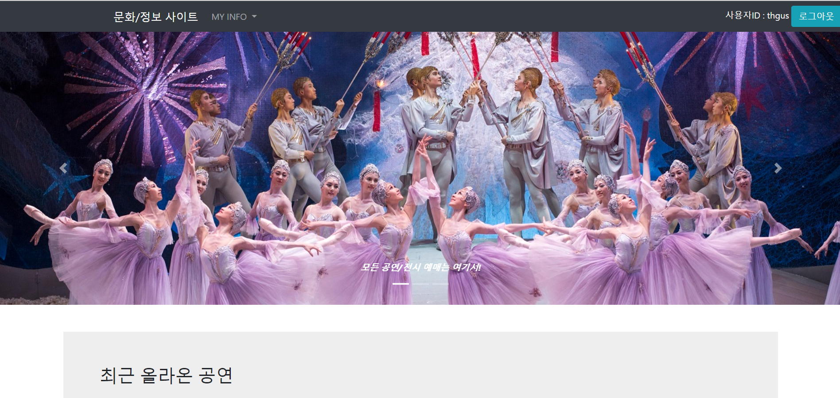
02 Introduction to Project Topics
Cultural Life Information Homepage Check out performance/exhibition, review, reservation information, etc.

Slide 4




03 Open Source

Slide 5
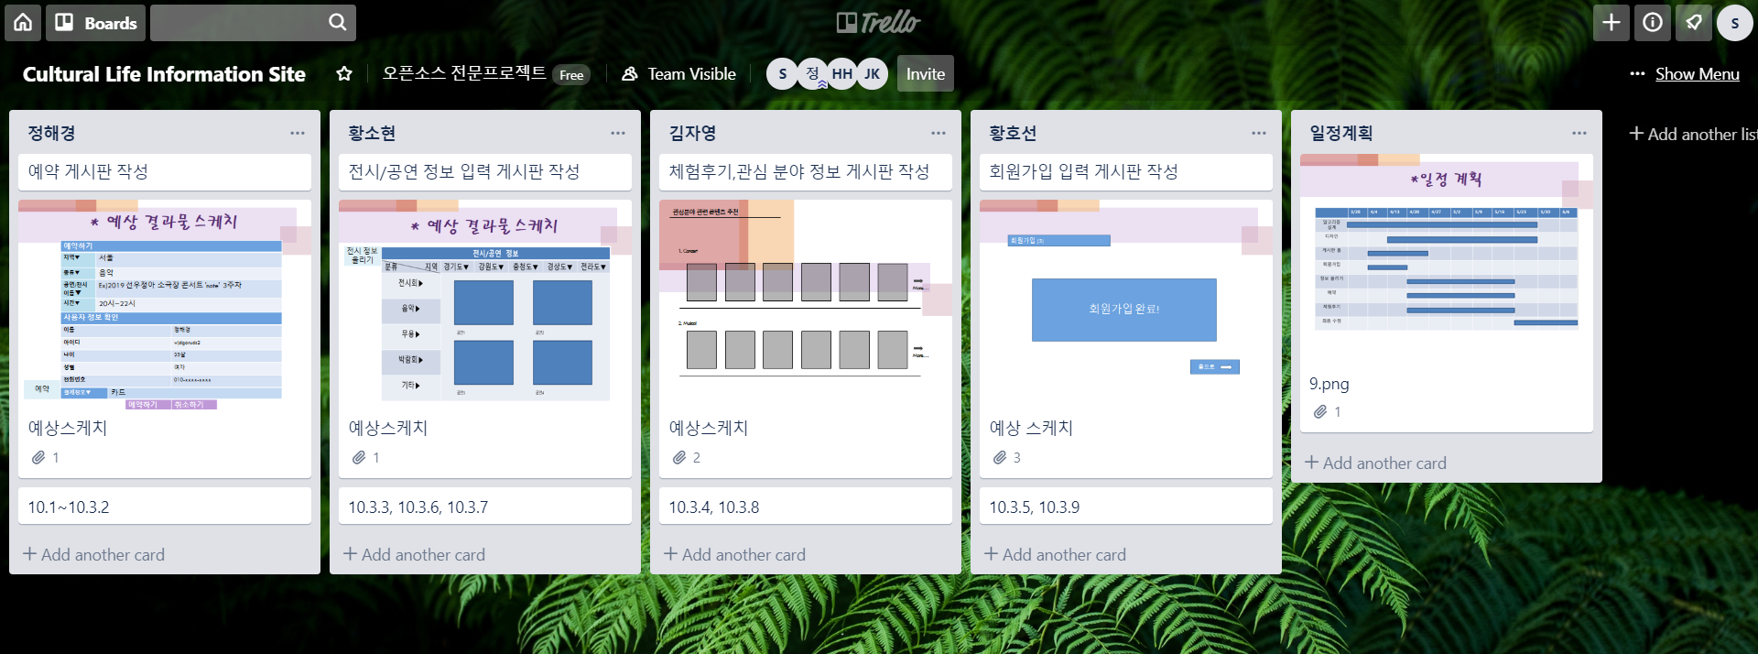
Division of roles through Trello

Slide 6
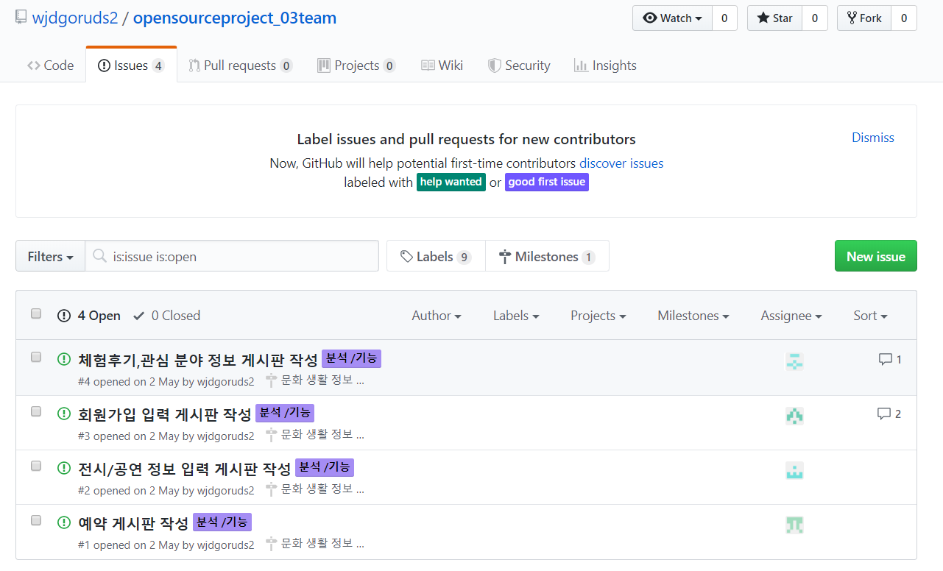
Project Management using GitHub

Slide 7
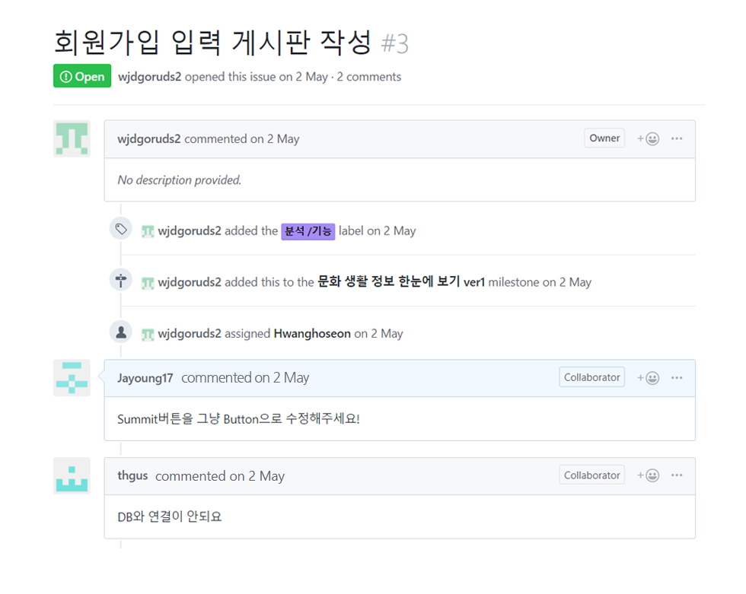
Project Management using GitHub

Slide 8
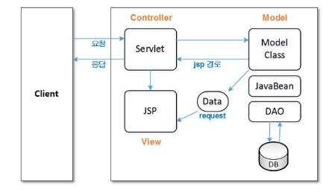
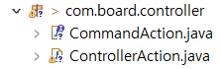
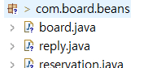
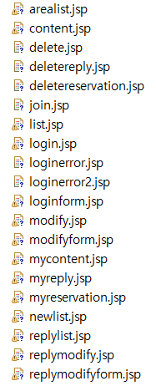
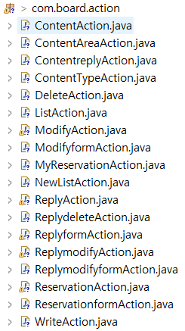
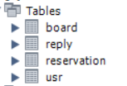
04 Class design

Slide 9
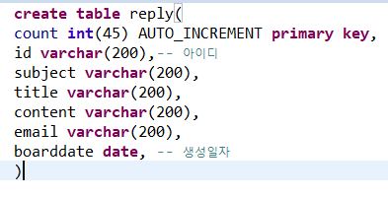
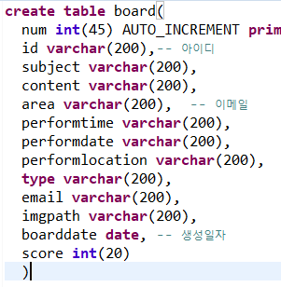
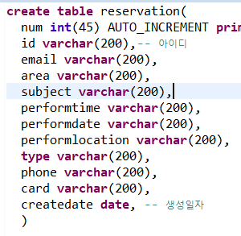
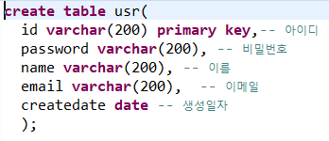
05 Data base design

Slide 10
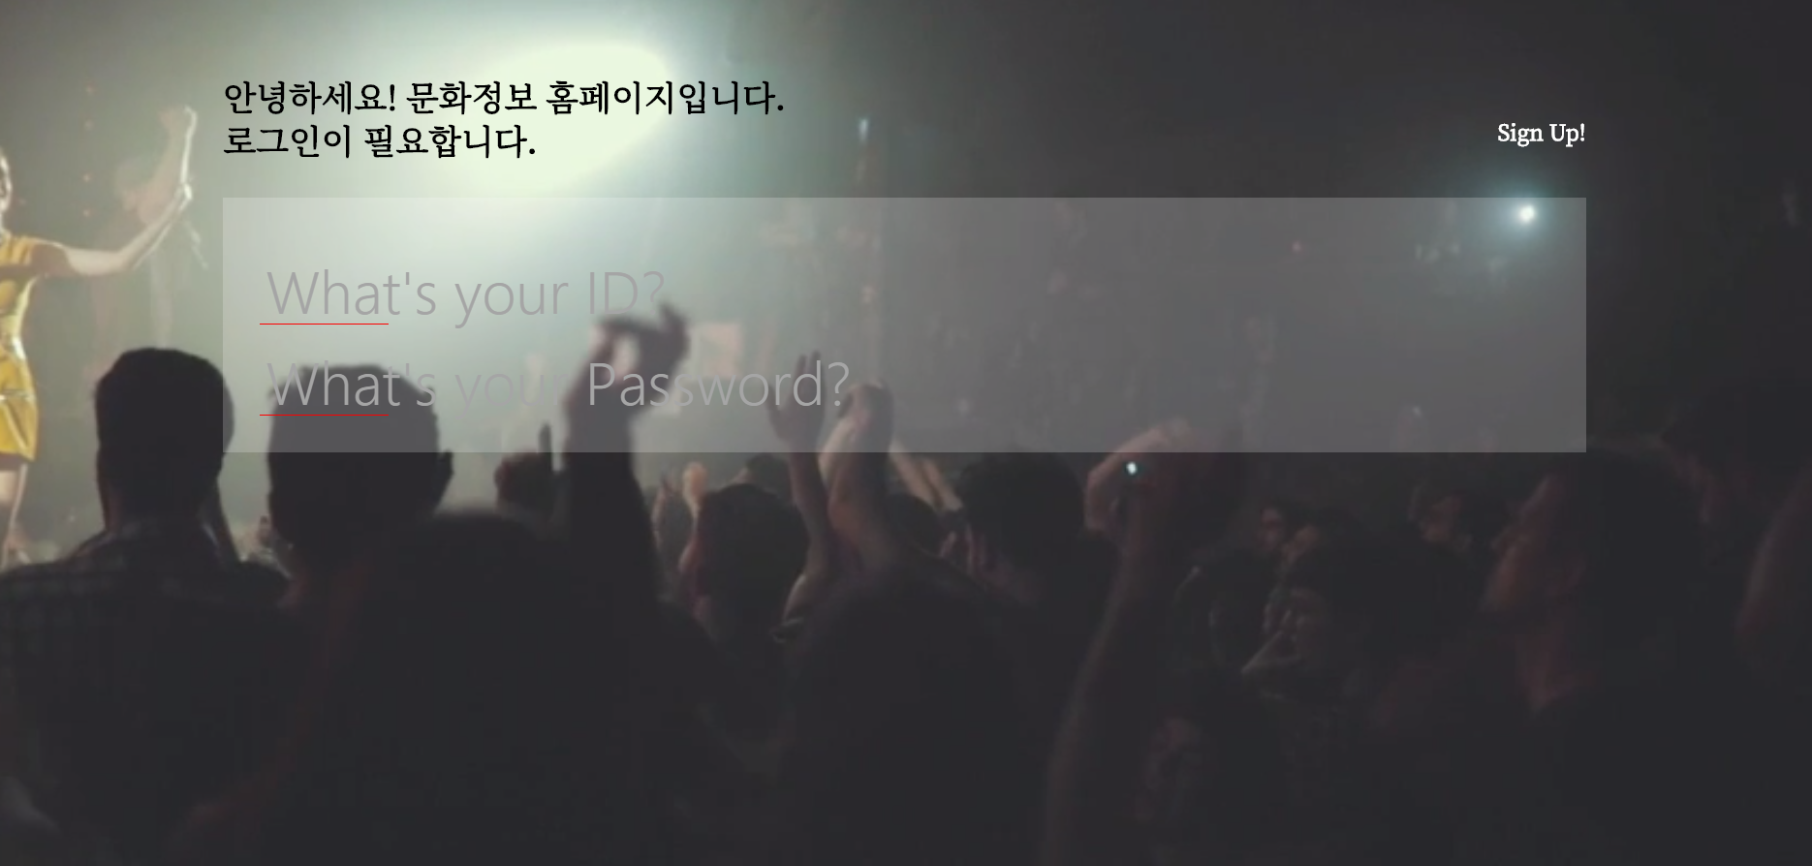
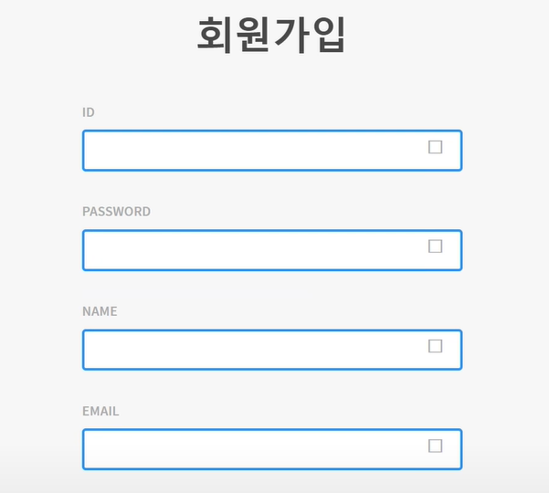
06 System design
1. Account
Login, Sign up

Slide 11
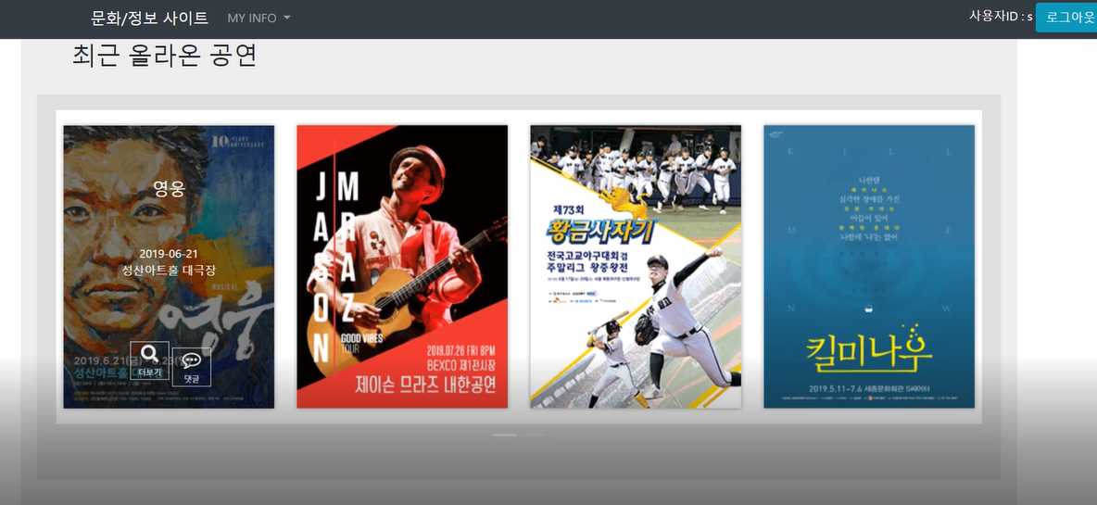
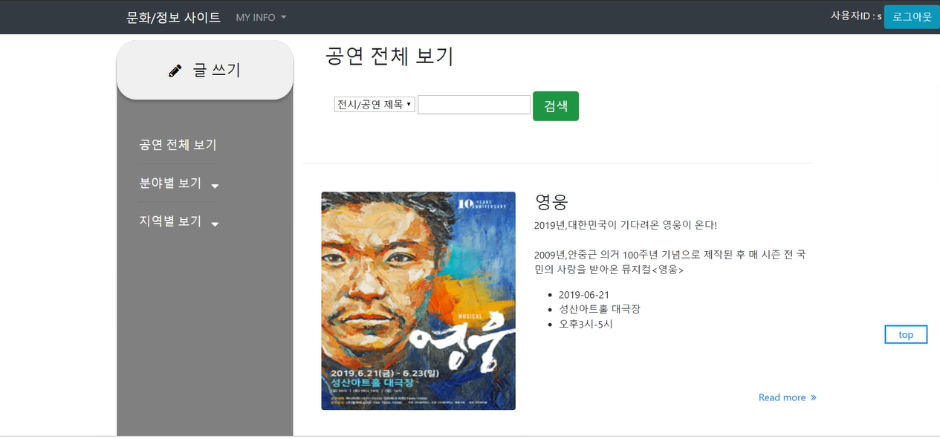
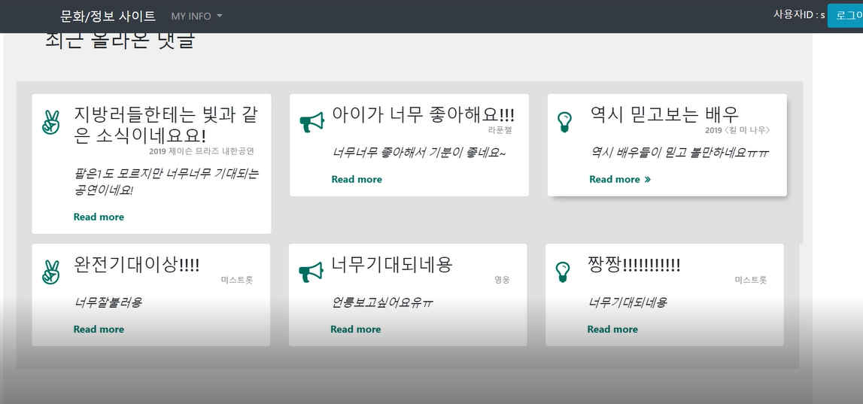
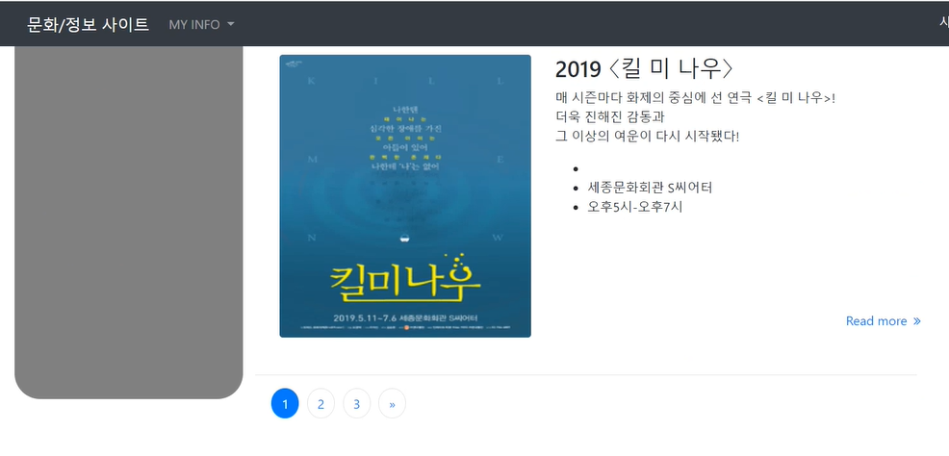
06 System design
…
2. List
Bulletin main screen, full list of posts, regional list view, sector list view

Slide 12
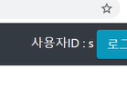
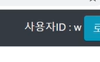
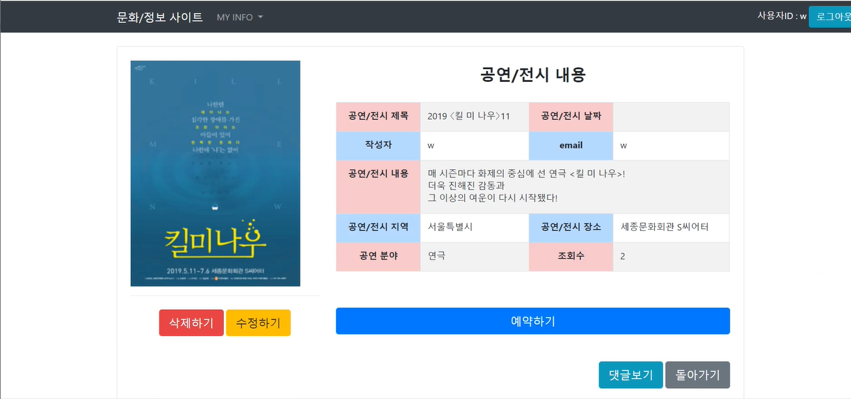
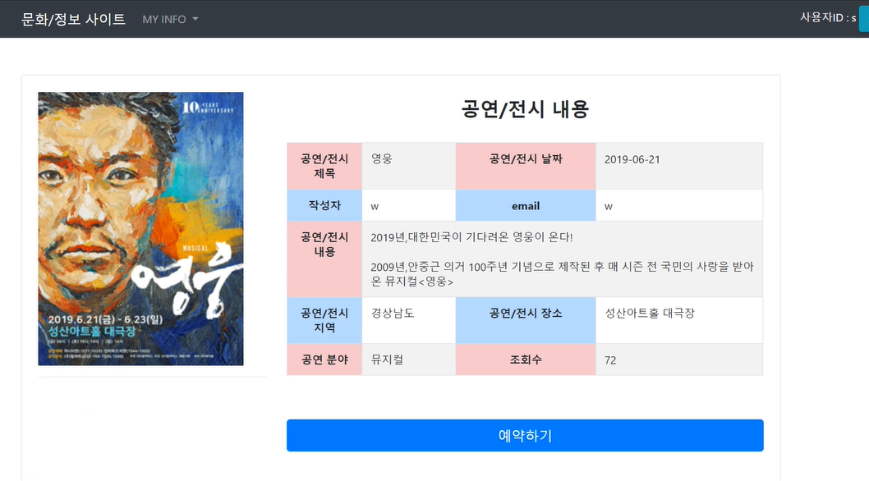
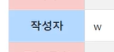
06 System design
3. Detail
Creating a post, deleting a post, modifying a post, viewing the details of a post,

Slide 13
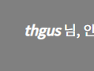
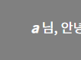
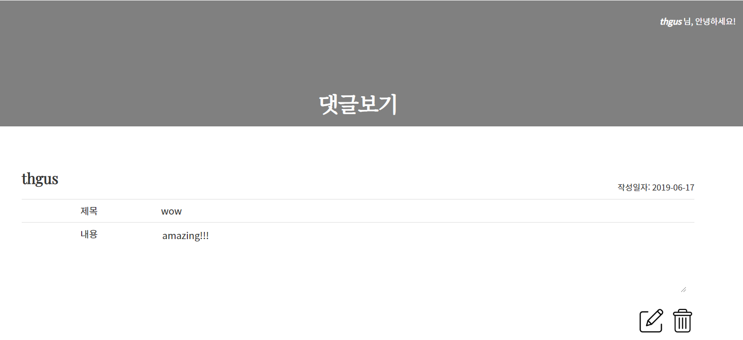
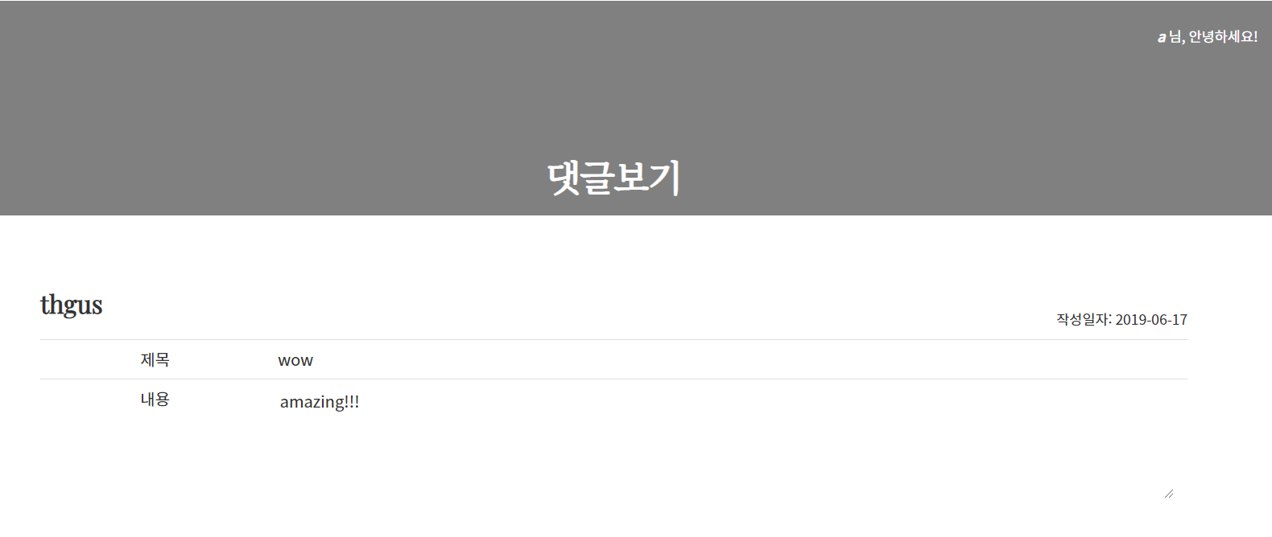
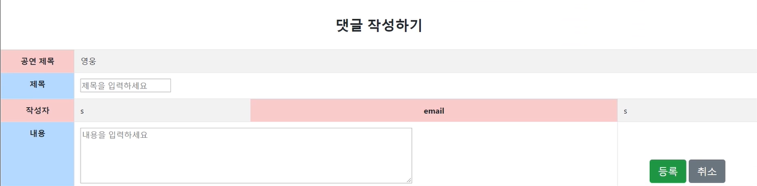
06 System design
4. Comment
Leave comments, delete comments, modify comments, view a list of comments

Slide 14

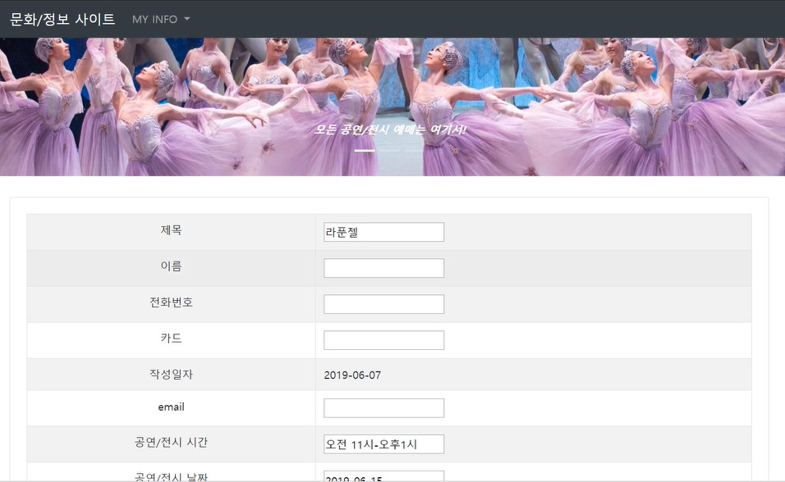
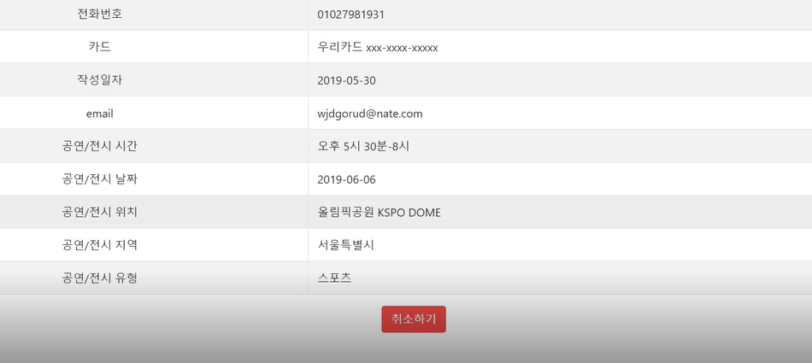
06 System design
5. Reservation
To make a reservation, cancel my reservation

Slide 15
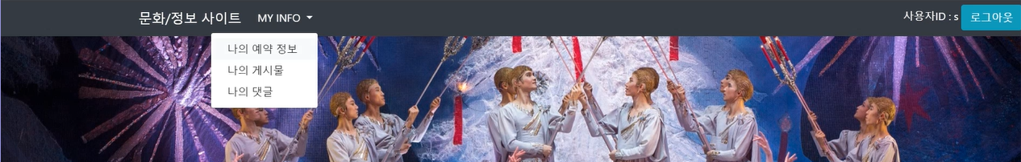
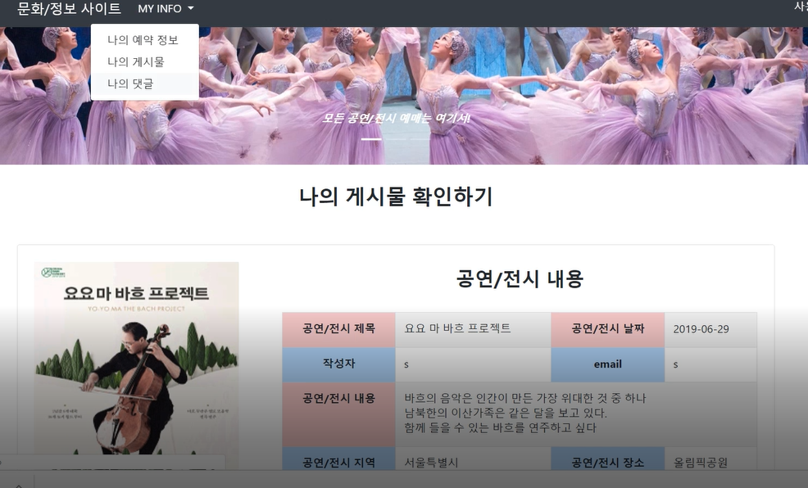
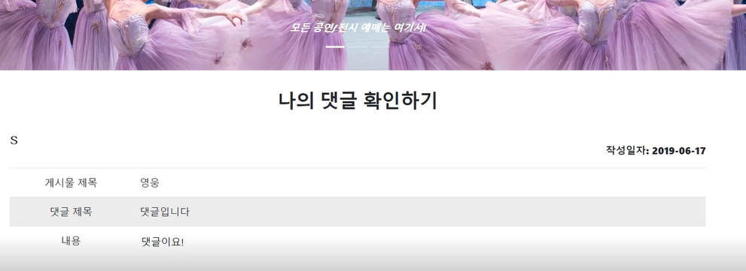
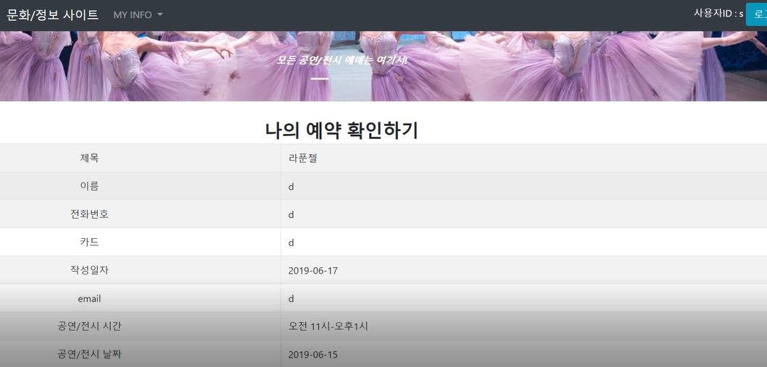
06 System design
6. My page
Viewing a list of posts I have created, view my list of comments, view my list of reservations

Slide 16




07 Advantage and disadvantages
Advantage:
Disadvantages:

Slide 17
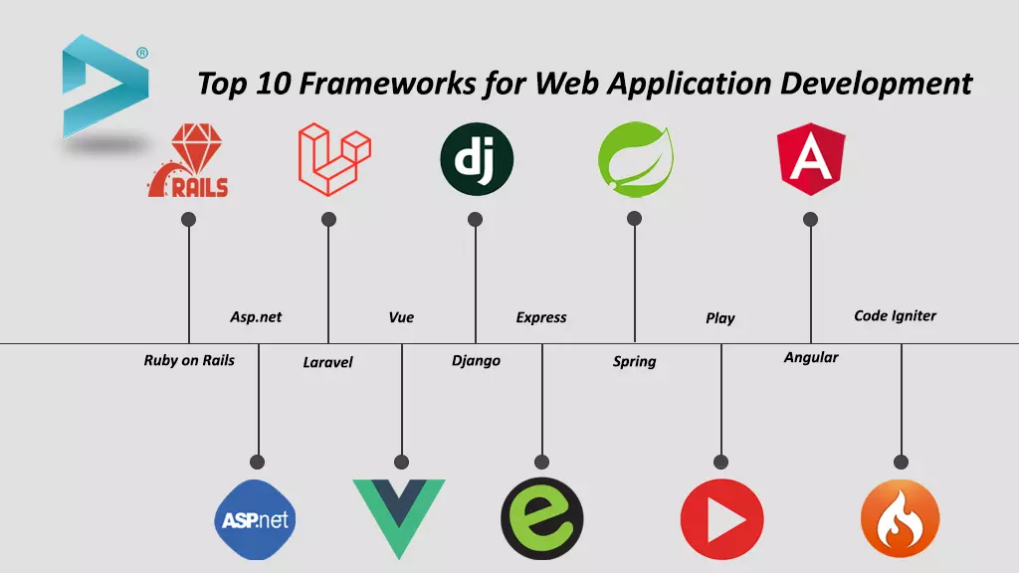
08 Project development
<Framework>
=>Using SPRING framework

Slide 18
END

